Slide 1
SOCIAL INVESTMENTS, MATERIAL “HAND-OUTS” AND POLITICIZATION OF POVERTY IN AFRICA
By
Ugwu Anthony Chinedu
&
Okoli Al Chukwuma
Department of Political Science Federal University of Lafia, Nigeria

Slide 2
Introduction
The place of public policy in modern political systems
Essence of the authoritative allocation of values
Guide to civic rationality, selflessness and due diligence for delivery of public good
African experience in policy formulation and implementation
The Nigerian case with social investment policy under president M. Buhari

Slide 3
Statement of the problem
Nigeria’s assumption of the global poverty capital
Under evaluation of the social investment programme (N-SIP) under Buhari
Preeminence of politics over professionalism
Use of N-SIP as electioneering strategy to lure the poor to vote even against themselves
Perpetuation of inequality and macro/micro economic imbalance

Slide 4
The state of the Art
Schools of thought on social investments
Scholars for the welfare state
Scholars for the social investment state
Popularity of the investment state over the welfare state
The neutral argument of actor and environmental factor as the critical determinants of social investment output

Slide 5
Theoretical Framework: Marxian Theory of production
The Historical/Accidental barriers to prosperity in Africa/ Nigeria
The story of Walter Rodney
The insights of Claude Ake
The post –independence Africa/ Nigeria
Nature of African Politics
Complications of global capitalism

Slide 6
The Eye of the Needle: N-SIP
Giant in size but dwarf in performance
Many have acclaimed the massive social investment programmes that have been unveiled by the Buhari administaration.
Six in number though four are more prominent

Slide 7
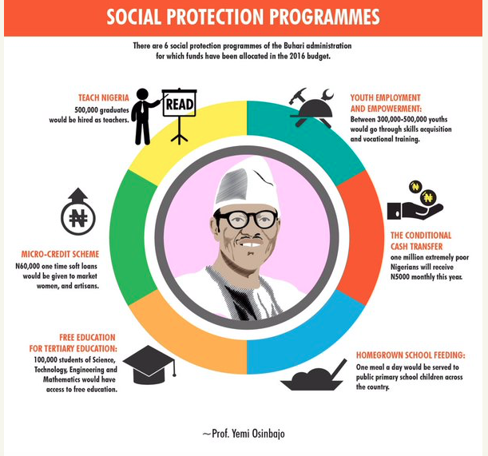
The six National Social Investment Programmes (N-SIP) under President Buhari

Slide 8
Reasons to smile
Obviously N-SIP has recorded some modest achievements
It has admitted that social investment programmes in Nigeria have failed in the past
It has also brought on board many partners within Nigeria and beyond to assist in the onerous task of realising SDG 1 in Nigeria in a record time
It has generated a credible data base for unemployed graduates in Nigeria. such data are needed for national planning.
Social and financial inclusion have been prioritized to reduce poverty and social conflicts

Slide 9
Not yet uhuru
Rising inequality
Insensitive political class
Corruption in N-SIP management
Weak bureaucracy
Poor funding
Poor data for adequate planning
Poor monitoring and evaluation mechanism

Slide 10
The Way Foward
Improve governance
Constitutionalising the package for sustainability
Strenghtening partnership to eradicate poverty
Building a self sustaining economy and moving away from rent and mono economy

Slide 11
Thanks
for
Listening

